Slide 1
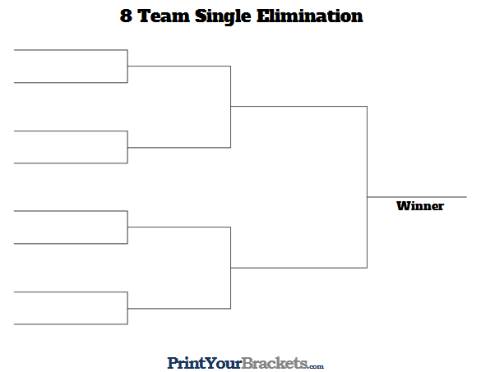
1. Jakob Schermuly
Jakob Schermuly
8. Josiah Starr
Jakob Schermuly
4. Asher Burns
Asher Burns $70.00
5. Averie Bourne
Jakob Schermuly $210.00
3. Jacob Duty
Jacob Duty $70.00
6. Elizabeth Lockwood
March 24, 2024
Olathe Lanes East, Olathe, KS
Division: U12 Mixed
Ellie Bleyenberg $115.00
2. Ellie Bleyenberg
Ellie Bleyenberg
7. Avery Davis

Slide 2
1. Joseph Parkins
Joseph Parkins $90.00
8. Will Winkelbauer
Michael Stanger $150
4. Trey Donath
Michael Stanger
5. Michael Stanger
Elias Grajeda-Sisson $270.00
3. Ryker Emerson
Ryker Emerson $90.00
6. Cooper Farmer
March 24, 2024
Olathe Lanes East, Olathe, KS
Division: U15 Mixed
Elias Grajeda-Sisson
2. Elias Grajeda-Sisson
Elias Grajeda-Sisson
7. Ian Norris

Slide 3
1. Olyvia Choura
Callie Vargas $115.00
8. Callie Vargas
Kaylin Wahlmeier $200.00
4. Kaylin Wahlmeier
Kaylin Wahlmeier
5. Paighton Crumley
Cortlynn Millington $355.00
3. Riley Emerson
Riley Emerson $115.00
6. Lauren Hubbard
March 24, 2024
Olathe Lanes East, Olathe, KS
Division: Open Girls
Cortlynn Millington
2. Cortlynn Millington
Cortlynn Millington
7. Caitlynn Clough

Slide 4
1. KJ Burns
KJ Burns
8. Noah Gibson $125.00
KJ Burns
4. Carter Schwiesow $125.00
Josh Hammons $190.00
5. Josh Hammons
KJ Burns $520.00
3. Josh Ingram $125.00
Connor Jahn
6. Connor Jahn
March 24, 2024
Olathe Lanes East, Olathe, KS
Division: Open Boys
Connor Jahn $325.00
2. Tyler Huffman
Tyler Huffman $190.00
7. PJ Dokolas $125.00

